Slide 1
Ciência de Dados Quântica Quantum Kernels and Feature Maps
Luís Paulo santos

Slide 2
Material de Consulta
[Schuld2021] – Secs. 2.5.4, 3.6.1; Chap. 6
“Supervised learning with quantum enhanced feature spaces” Vojtech Havlicek et al. https://arxiv.org/pdf/1804.11326.pdf
Qiskit Global Summer School 2021: Lectures 6.1, 6.2, 7.1, 10.2 https://www.youtube.com/watch?v=xgA4Dx_7q34&list=PLOFEBzvs-VvqJwybFxkTiDzhf5E11p8BI
“A rigorous and robust quantum speed-up in supervised machine learning”; Yunchao Liu, Srinivasan Arunachalam, Kristan Temme; Nature Physics volume 17, pages1013–1017 (2021) https://arxiv.org/pdf/2010.02174.pdf

Slide 3

Recalling Classical Kernels (1/6)
LSM Linear Classifiers
model: $f_{θ}\left(x\right)=w^{T}x+b=θ_{0}+θ_{1}x_{1}+⋯+θ_{d}x_{d}=θ^{T}x=\left\langle θ,x\right\rangle$
classification: $label\left(x\right)=sign\left(f_{θ}\left(x\right)\right)$
learning: $θ_{}^{(t+1)}=θ_{}^{(t)}+η\left(y^{(i)}−\left\langle θ^{\left(t\right)},x^{\left(i\right)}\right\rangle \right)x^{\left(i\right)}$
SVM Linear classifiers:
primal model: $f_{w,b}\left(x\right)=w^{T}x+b$
dual model: $f_{α}\left(x\right)=\sum_{i∈S}{\left(α_{i}y^{(i)}\left\langle x^{(i)},x\right\rangle \right)}+b$, $S$ is the set of support vectors indexes
classification: $label\left(x\right)=sign\left(f_{α}\left(x\right)+b\right)$
learning: $\max_{α}\left(\sum_{i∈S}{α_{i}}−\frac{1}{2}\sum_{i,j}^{M,M}{α_{i}α_{j}y^{(i)}y^{(j)}\left\langle x^{(i)},x^{(j)}\right\rangle }\right)$
In the primal model $w$defines the classification hyperplane.
For SVMs the dual model allows solving for the support vectors, instead of computing $w$ explicitly, if inner products can be efficiently computed.

Slide 4

Recalling Classical Kernels (2/6)
SVM Linear classifiers:
primal model: $f_{w,b}\left(x\right)=w^{T}x+b$
dual model: $f_{α}\left(x\right)=\sum_{i∈S}{\left(α_{i}y^{(i)}\left\langle x^{(i)},x\right\rangle \right)}+b$, $S$ is the set of support vectors indexes
classification: $label\left(x\right)=sign\left(f_{α}\left(x\right)\right)$
learning: $\max_{α}\left(\sum_{i∈S}{α_{i}}−\frac{1}{2}\sum_{i,j}^{M,M}{α_{i}α_{j}y^{(i)}y^{(j)}\left\langle x^{(i)},x^{(j)}\right\rangle }\right)$
The use of inner products for learning and classification implies that the algorithms do not really care where the data points are in the data space, but rather on how similar the data points are: inner products are a measure of similarity

Slide 5
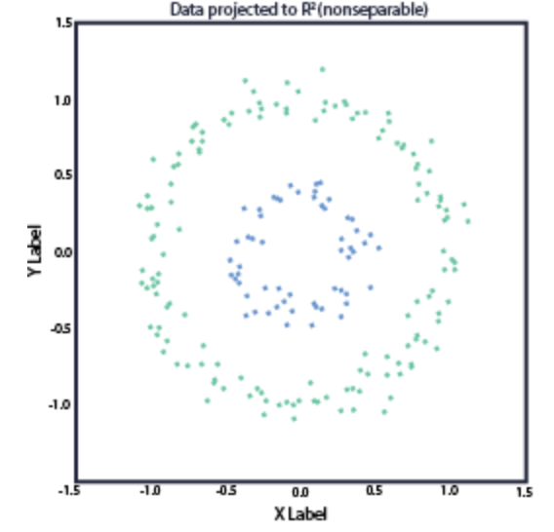
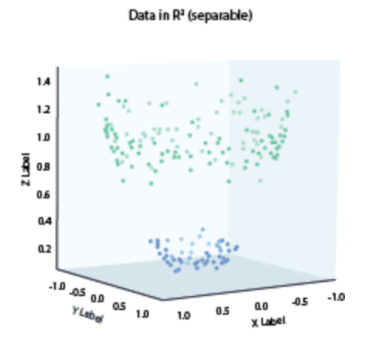


Recalling Classical Kernels (3/6)
Linear models are only accurate if the data is linearly separable
Feature maps $φ\left(∙\right)$ raise the dimensionality of the data $φ:ℝ^{k}→ℝ^{p}$
$$φ\left(x\right)$$
The data is expected be linearly separable in the higher dimensionality feature space

Slide 6

Recalling Classical Kernels (4/6)
LSM Linear Classifiers with feature map
model: $f_{θ}\left(x\right)=\left\langle θ,φ\left(x\right)\right\rangle$
learning: $θ_{}^{(t+1)}=θ_{}^{(t)}+η\left(y^{(i)}−\left\langle θ^{\left(t\right)},φ\left(x^{\left(i\right)}\right)\right\rangle \right)φ\left(x^{\left(i\right)}\right)$
SVM Linear classifiers:
dual model: $f_{α}\left(x\right)=\sum_{i∈S}{\left(α_{i}y^{(i)}\left\langle φ\left(x^{\left(i\right)}\right),φ\left(x\right)\right\rangle \right)}+b$, $S$ is the set of support vectors indexes
learning: $\max_{α}\left(\sum_{i=1}^{M}{α_{i}}−\frac{1}{2}\sum_{i,j}^{M,M}{α_{i}α_{j}y^{(i)}y^{(j)}\left\langle φ\left(x^{\left(i\right)}\right),φ\left(x^{\left(j\right)}\right)\right\rangle }\right)$
Computing an inner product in the feature space is now $𝒪\left(p\right)$ instead of $𝒪\left(k\right)$ and this represents a huge computational burden, since usually $p≫k$ . In fact some feature maps imply $p=∞$

Slide 7

Recalling Classical Kernels (5/6)
Let $κ_{φ}\left(x,z\right)=\left\langle φ\left(x\right),φ\left(z\right)\right\rangle$ be the kernel, a measure of similarity between $φ\left(x\right)$ and $φ\left(z\right)$
It can be shown that for feature maps obeying Mercer’s condition the respective kernel can be evaluated with complexity $𝒪\left(k\right)$ and not with complexity $𝒪\left(p\right)$, i.e.
we get the linearly separability advantage of working in the p-dimensional feature space
with a cost proportional to the k-dimensionality of the original data space
This is possible because the algorithm does not care where the points $φ\left(x\right)$ and $φ\left(z\right)$ lie in the p-dimensional feature space, but rather on their similarity $κ_{φ}\left(x,z\right)=\left\langle φ\left(x\right),φ\left(z\right)\right\rangle$

Slide 8

Recalling Classical Kernels (6/6)
Examples of kernels:
Polynomial kernel
$κ_{d}\left(x,z\right)={\left(\left\langle x,z\right\rangle +c\right)}^{d}$
$p=\left(\begin{matrix}k+d \\ d\end{matrix}\right)=\frac{\left(k+d\right)!}{k!d!}$
Gaussian Kernels (Radial Basis Functions):
$κ_{σ}\left(x,z\right)=e^{−\left(\frac{{\left\|x−z\right\|}^{2}}{2σ^{2}}\right)}$
$p=∞$

Slide 9

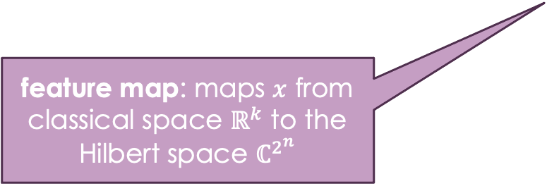




What is on a VQC? (1/5)
$$\left. \left|ψ\right.\right\rangle =φ\left(x\right)\left. \left|0\right.\right\rangle$$
data encoding
arbitrary measurement (observable) with Hamiltonian H
$$\left.\left|0\right.\right\rangle$$
$$φ\left(x\right)$$
$$M_{H}$$
feature map: maps $x$ from classical space $ℝ^{k}$ to the Hilbert space $ℂ^{2^{n}}$
labels are extracted from the expected value of the observable
$$\left\langle \left.ψ\right\rceil \right.H\left.\left|ψ\right.\right\rangle =\left\langle \left.φ\left(x\right)\right|\right. H \left.\left|φ\left(x\right)\right.\right\rangle$$

Slide 10

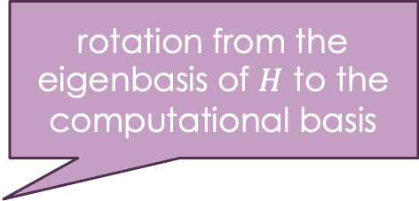




What is on a VQC? (2/5)
rotation from the eigenbasis of $H$ to the computational basis
measurement (observable) in the computational (diagonal) basis
$$\left.\left|0\right.\right\rangle$$
$$φ\left(x\right)$$
$$W$$
$$M_{\left\langle z\right\rangle }$$
conceptually we can think that a rotation from $H$ eigenbasis to the computational basis is included as circuit $W$
for an arbitrary $H$ the rotation $W$ requires exponential time (depth)
labels are extracted from the expected value of the observable:
$$\left\langle \left.φ\left(x\right)\right|\right. W^{†} Z W \left.\left|φ\left(x\right)\right.\right\rangle$$

Slide 11





What is on a VQC? (3/5)
parameterizable quantum circuit
$$\left.\left|0\right.\right\rangle$$
$$φ\left(x\right)$$
$$W_{θ}$$
$$M_{\left\langle z\right\rangle }$$
In a VQC $W$ is parameterized as $W_{θ}$
The model is the expected value of the observable:
$$f_{θ}\left(x\right)=\left\langle \left.φ\left(x\right)\right|\right. {W_{θ}}^{†} Z W_{θ} \left.\left|φ\left(x\right)\right.\right\rangle$$
The label is obtained as
$$label\left(x\right)=sign \left(f_{θ}\left(x\right)+b\right)$$

Slide 12





What is on a VQC? (4/5)
$$\left.\left|0\right.\right\rangle$$
$$φ\left(x\right)$$
$$W_{θ}$$
$$M_{\left\langle z\right\rangle }$$
What is $W_{θ}$?
we can think of it as a parametrizable change of basis
thus we can think of it as parameterizing the observable’s Hamiltonian
It can be shown that
$$label\left(x\right)=sign \left(f_{θ}\left(x\right)+b\right)=sign\left(\left\langle \left.φ\left(x\right)\right|\right. {W_{θ}}^{†} Z W_{θ} \left.\left|φ\left(x\right)\right.\right\rangle +b\right)$$
is a linear model! (see here, for instance)

Slide 13

What is on a VQC? (5/5)
$$\left.\left|0\right.\right\rangle$$
$$φ\left(x\right)$$
$$W_{θ}$$
$$M_{\left\langle z\right\rangle }$$
What is $W_{θ}$?
given that a VQC is a linear model then $W_{θ}$ is optimizing over our choices of hyperplanes ($W_{θ}$ determines the classification hyperplane) thus we can think of it as parameterizing the observable’s Hamiltonian
But $W_{θ}$, i.,e. the ansatze, in feasible VQCs do not have exponential time complexity (depth), thus:
$W_{θ}$is parameterizing over a (very) small subset of all possible hyperplanes, not including, with high probability, the optimal hyperplane

Slide 14
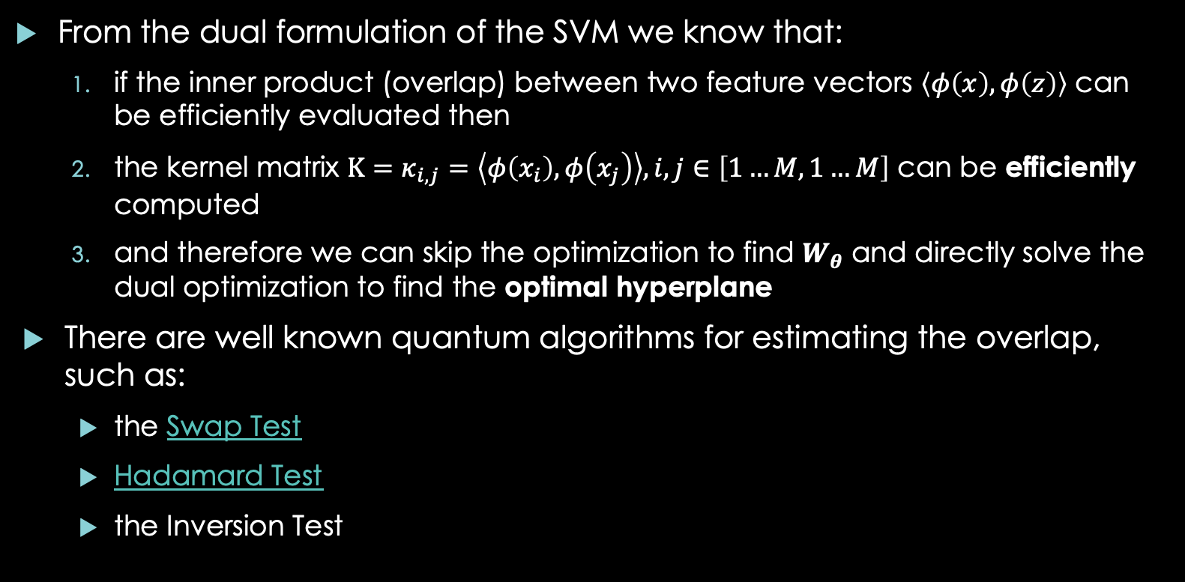
VQCs and Quantum Kernel Estimation
From the dual formulation of the SVM we know that:
if the inner product (overlap) between two feature vectors $\left\langle φ\left(x\right),φ\left(z\right)\right\rangle$ can be efficiently evaluated then
the kernel matrix $Κ=κ_{i,j}=\left\langle φ\left(x_{i}\right),φ\left(x_{j}\right)\right\rangle , i,j∈\left[1…M,1…M\right]$ can be efficiently computed
and therefore we can skip the optimization to find $W_{θ}$ and directly solve the dual optimization to find the optimal hyperplane
There are well known quantum algorithms for estimating the overlap, such as:
the Swap Test
Hadamard Test
the Inversion Test

Slide 15

VQCs and Quantum Kernel Estimation
Quantum Kernel Estimation (QKE) can be efficiently computed using, for instance, the Inversion Test
The Kernel Matrix can therefore be efficiently computed using quantum resources
The SVM dual optimization problem can then be efficiently solved using classical resources
In this sense:
$VQC ⊂QKE$, since QKE has access to the optimal hyperplane
$QKE≡VQC$ for an optimally solved exponentially deep $W_{θ}$

Slide 16




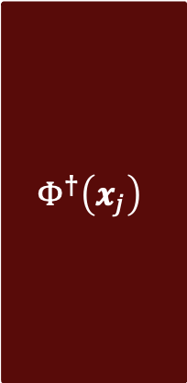


Quantum Kernel Estimation (QKE)
Hybrid classical quantum kernel methods are based on the quantum estimation of a similarity metric on a feature space: $κ\left(x_{i},x_{j}\right)={\left|\left\langle φ\left(x_{i}\right),φ\left(x_{j}\right)\right\rangle \right|}^{2}$
QKE amounts to estimating the transition probability
$$\left\langle \left.0\right|\right.Φ^{†}\left(x_{j}\right)Φ\left(x_{i}\right)\left.\left|0\right.\right\rangle ={\left|\left\langle φ\left(x_{i}\right),φ\left(x_{j}\right)\right\rangle \right|}^{2}=κ\left(x_{i},x_{j}\right)=P\left(\left.\left|0\right.\right\rangle \right)$$
for i=1 to M-1
for j=i+1 to M
M0 = 0
for R shots:
execute circuit and measure
if $\left.\left|0\right.\right\rangle$ M0 += 1
$Κ\left[i,j\right]=Κ\left[j,i\right]=\tilde{P}\left(\left.\left|0\right.\right\rangle \right)={M0}/R$
$$\left.\left|0\right.\right\rangle$$
$$Φ\left(x_{i}\right)$$
$$Φ^{†}\left(x_{j}\right)$$
$$\tilde{P}\left(\left.\left|0\right.\right\rangle \right)=P\left(\left.\left|0\right.\right\rangle \right)+𝒪\left({\sqrt{R}}^{−1}\right)$$
$$\left.\left|0\right.\right\rangle$$
additive error

Slide 17

Quantum Kernel Estimation (QKE)
Choosing $Φ\left(x\right)$ :
must be a unitary
should depend non linearly on $x$
$\left\langle \left.0\right|\right.Φ^{†}\left(x_{j}\right)Φ\left(x_{j}\right)\left.\left|0\right.\right\rangle$ should be computationally hard to evaluate classically
Keep in mind that $\tilde{κ}\left(x_{i},x_{j}\right)=κ\left(x_{i},x_{j}\right)+𝒪\left({\sqrt{R}}^{−1}\right)$
a classical computer might achieve the same additive error with the same efficiency for many kernels by stochastic sampling

Slide 18





Quantum Kernel Estimation (QKE)
$$x^{1}$$
$$U^{1}\left(x^{1}\right)$$
Trivial cases $x=\left(x^{1},⋯,x^{n}\right)$
product states
$Φ\left(x\right)=⨂_{j=1}^{n}\left(U^{j}\left(x^{j}\right) \right)$
$U^{j}\left(x^{j}\right)=R_{Y}(x^{j}$)
$κ\left(x,z\right)=\left\langle \left.0\right|\right.Φ^{†}\left(z\right)Φ\left(x\right)\left.\left|0\right.\right\rangle =\prod_{j=1}^{n}{\left(\left\langle \left.0\right|\right.{R_{Y}}^{†}\left(z^{j}\right)R_{Y}\left(x^{j}\right)\left.\left|0\right.\right\rangle \right)}=\prod_{j=1}^{n}{{\cos\left(\frac{x^{j}−z^{j}}{2}\right)}^{2}}$
amplitude encoding $\left.\left|Ψ\right.\right\rangle =\sum_{j=1}^{n}{x^{j} \left.\left|j\right.\right\rangle }$ $⟺$ polynomial kernels
$$x^{n}$$
$$U^{n}\left(x^{n}\right)$$

Slide 19
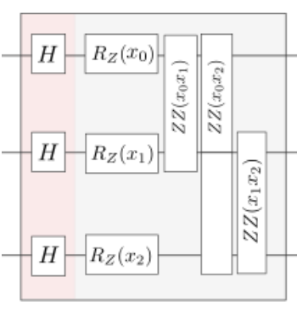




Quantum Kernel Estimation (QKE)
$$Φ\left(x\right)$$
$$x^{1}$$
Trivial cases $x=\left(x^{1},⋯,x^{n}\right)$
IQP (single layer)
$κ\left(x,y\right)=\left\langle \left.0\right|\right.Φ^{†}\left(y\right)Φ\left(x\right)\left.\left|0\right.\right\rangle$
$κ\left(x,y\right)={\left|\frac{1}{2^{n}}\sum_{z={\left\{−1,1\right\}}^{n}}{\left[exp\left(i\left(\sum_{j}{\left(φ_{j}\left(x\right)−φ_{j}\left(y\right)\right)z^{j}}+\sum_{j,t}{\left(φ_{j,t}\left(x\right)−φ_{j,t}\left(y\right)\right){z^{t}z}^{j}}\right)\right)\right]}\right|}^{2}$ where $φ_{∙}\left(∙\right)$ is the phase induced by the rotation gates
exponentially hard summation, but
can be uniformly sampled for $z∈{\left\{−1,1\right\}}^{n}$, with additive error $𝒪\left({\sqrt{R}}^{−1}\right)$
no quantum computational advantage
$$x^{n}$$

Slide 20
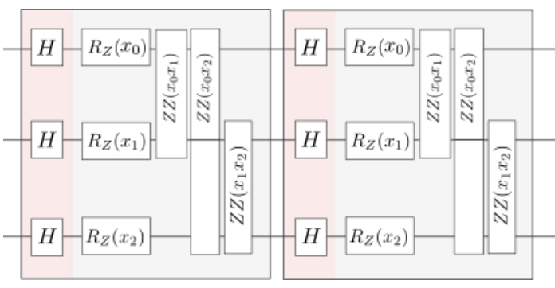









Quantum Kernel Estimation (QKE)
$$x^{1}$$
$$U^{1}\left(x^{1}\right)$$
$$U^{1}\left(x^{1}\right)$$
Suggestions for computational hardness:
product states: interleave multiple layers of rotations with entanglement gates
IQP: use multiple layers
$$x^{n}$$
$$U^{n}\left(x^{n}\right)$$
$$U^{n}\left(x^{n}\right)$$
$$Φ\left(x\right)$$
$$x^{1}$$
$$x^{n}$$

Slide 21













Quantum Kernel Estimation (QKE)
Suggestions for computational hardness:
ZZFeatureMap: configurable feature map available on Qiskit
$$x^{1}$$
$$H$$
$$R_{Z}\left(2∗φ\left(x^{1}\right)\right)$$
$$R_{ZZ}\left(2∗φ\left(x^{1},x^{2}\right)\right)$$
$$x^{2}$$
$$H$$
$$R_{Z}\left(2∗φ\left(x^{2}\right)\right)$$
$$R_{ZZ}\left(2∗φ\left(x^{2},x^{3}\right)\right)$$
$$x^{3}$$
$$H$$
$$R_{Z}\left(2∗φ\left(x^{3}\right)\right)$$
$$φ\left(x^{i}\right)=x^{i}$$
$$φ\left(x^{i},x^{j}\right)=\left(π−x^{i}\right)\left(π−x^{j}\right)$$

Slide 22

Quantum Kernel Estimation (QKE)
The feature map cannot be too complex, otherwise it won’t generalize
The Kernel matrix will approach the identity matrix
in practice $\left.\left|0\right.\right\rangle$ will seldom be observed in the QKE process
There is a single feature map, the DLOG, for which classical hardness has been proved:
“A rigorous and robust quantum speed-up in supervised machine learning”, 2020; https://arxiv.org/pdf/2010.02174.pdf
It is demonstrated on a very artificial problem, and its usefulness for real world problems is not clear

Slide 23

Quantum Kernel Alignment
Can the quantum kernel be parameterized and its parameters learnt?
Generalization error $ε$: probability that the classifier misclassifies test points
Idea: bound the generalization error for the SVM classifier (for M points)
$$ε≤𝒪\left(\frac{\max_{α}\left(ℒ\left(α\right)\right)}{M}\right)=𝒪\left(\frac{\max_{α}\left(\sum_{m=1}^{M}{α^{m}}−\frac{1}{2}\sum_{m,m^{′}=1}^{M}{α^{m}α^{m^{′}}y^{m}y^{m^{′}}κ\left(x^{m},x^{m^{′}}\right)}\right)}{M}\right)$$
The kernel can be parameterized $κ_{λ}\left(x^{m},x^{m^{′}}\right)$ and the bound optimized:
$$ε≤𝒪\left(\frac{\min_{λ}{\max_{α}\left(ℒ\left(α,λ\right)\right)}}{M}\right)$$

Slide 24
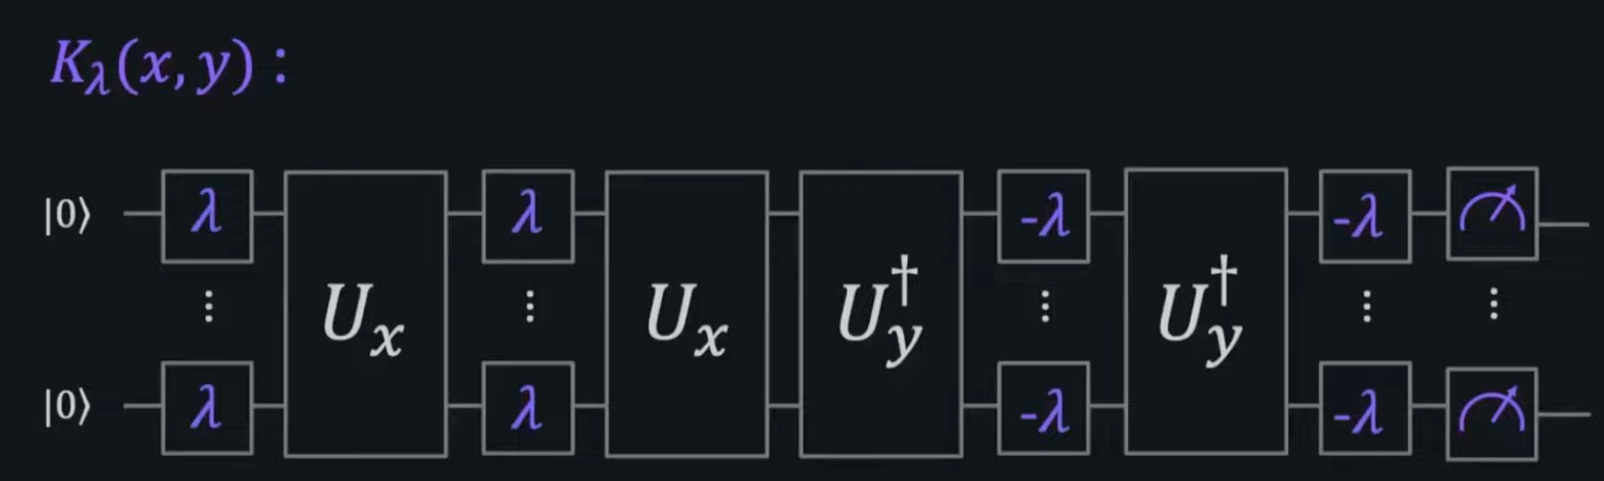
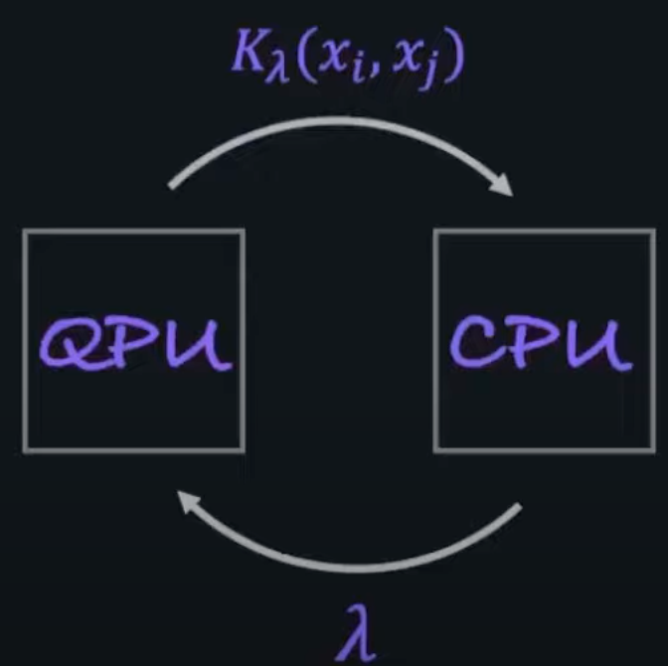
Quantum Kernel Alignment

Slide 25
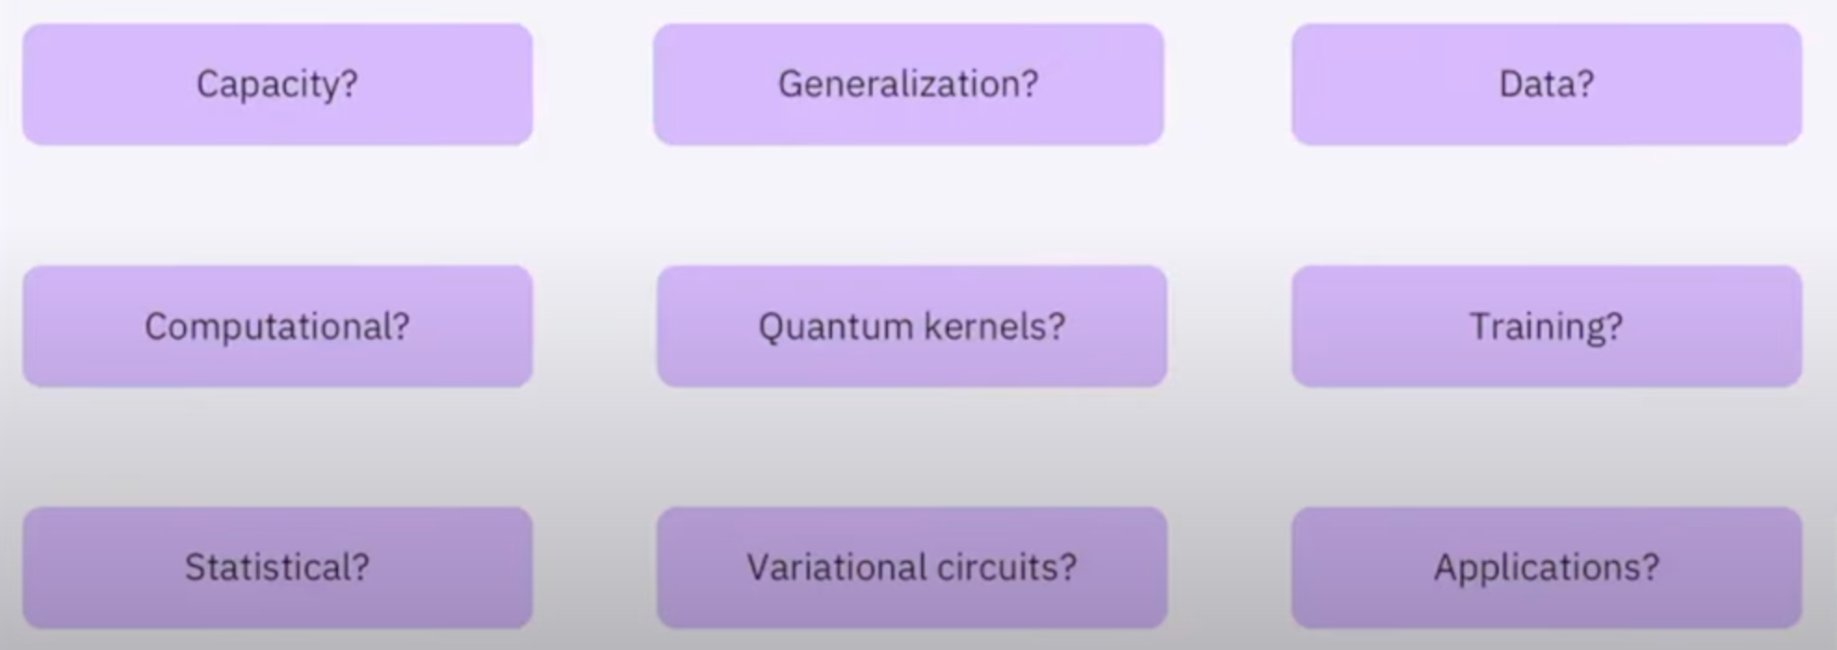
Where is QML’s advantage?

Slide 26
Summary
Quantum kernels can only be expected to perform better than classical kernels if they are hard to estimate classically. This a necessary, but not sufficient condition
Quantum kernels can be optimized for a data set using kernel alignment
The advantage of QML w.r.t. classical ML has still to be found, formalized and demonstrated.

